Slide 1
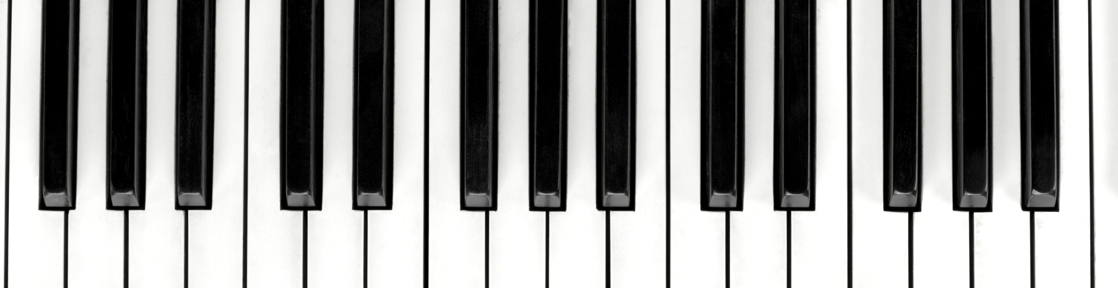
Melody Maker: Revolutionizing Music Production
Aniket Kumar Yadav(21csu487)
Mayank(21csu506)
Lokesh Yadav(21csu504)
Ravi(21csu525)
Nadeem(21csu515)

Slide 2

INTRODUCTION
Melody Maker is a cutting-edge music production application developed using Flutter, aimed at empowering users to create, edit, and produce their own music tracks seamlessly. The app caters to both amateur musicians and seasoned producers by providing a user-friendly interface coupled with powerful audio processing capabilities.
Mission: Empowering users to create, edit, and produce music seamlessly
Target Audience: Amateur musicians and seasoned producers.
Key Features: User-friendly interface, powerful audio processing capabilities

Slide 3
PROBLEM STATEMENT
Current gap in music production applications.
Need for a comprehensive, user-friendly mobile app.
Challenges of existing solutions on mobile platforms

Slide 4
DESIGN OVERVIEW
Data/Input Output Description: Audio input and processed audio output.
Algorithmic Approach:
Audio Capture Algorithm
Audio Effects Application
State Management Architecture
Responsive UI Design

Slide 5
AUDIO CAPTURE ALGORITHM
Initializing Microphone Input:
Utilize platform-specific APIs to initialize microphone input.
Set up audio session configurations such as sample rate, channel count, and bit depth.
Ensure compatibility across different smartphone platforms (Android and iOS).
Specifying Sample Rates and Bit Depth:
Determine optimal settings for capturing high-quality audio while considering device capabilities.
Adjust sample rates and bit depth based on user preferences and application requirements.
Provide options for users to customize audio settings according to their needs.

Slide 6
AUDIO EFFECT APPLICATION
Effect Chain Processing
Real-time Processing
Implement a modular approach where audio effects can be added to a chain and applied sequentially.
Ensure efficient processing of audio data to minimize latency and maintain audio quality.
Develop algorithms optimized for real-time audio processing to ensure instantaneous application of effects.
Utilize multi-threading and parallel processing techniques to handle audio data efficiently.

Slide 7
STATE MANAGEMENT ARCHITECTURE
Provider Integration
Reactivity for Real-time Audio Processing
Integrate Provider for managing the app's state in a reactive and efficient manner.
Utilize Provider scoped model to manage global and local states across different parts of the application.
Implement state listeners to update UI components in response to changes in app state.
Ensure that changes in audio processing parameters or playback state trigger updates to the app's state.
Utilize state management to synchronize audio playback, effect settings, and UI components in real-time.
Optimize state updates to minimize performance overhead.

Slide 8
RESPONSIVE UI DESIGN
Adaptive Layouts :- Design layouts using Flutter's flexible layout system to adapt to different screen sizes and orientations.
Intuitive Touch Controls :- Implement intuitive touch gestures for common tasks such as recording, playback, and adjusting audio parameters.
Interactive Elements :- Implement gesture handling for interactive elements to support actions like dragging, zooming, and adjusting controls.
State Management :- Implementation of State Management Architecture.

Slide 9

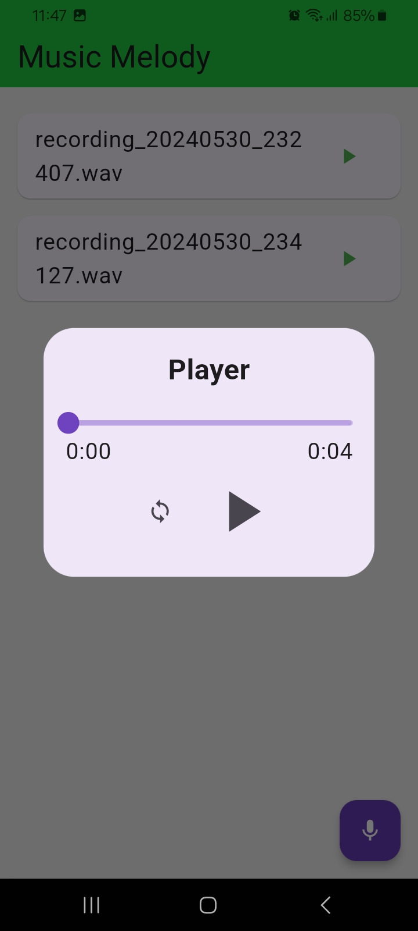
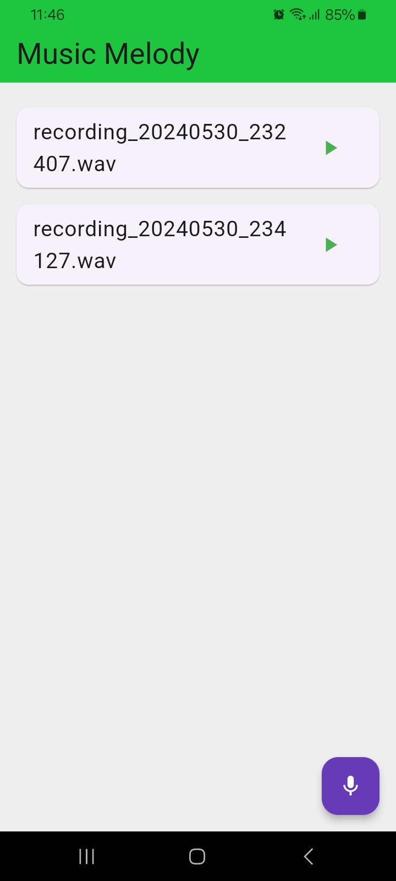
CORE FUNCTIONALITIES
Audio Recording Module
Audio Effects Module
Looping and Samples Module

Slide 10
FUTURE ENHANCEMENT
Expand library of audio effects and samples.
Implement collaborative features that allow multiple users to work on a music project simultaneously.
Partner with online music marketplaces to integrate Melody Maker with their platforms.

Slide 11
CONCLUSION
In conclusion, Melody Maker represents the culmination of our efforts to revolutionize music production. We've created a powerful tool that empowers users of all levels to craft their own music seamlessly. Our gratitude extends to our team, stakeholders, and partners for their invaluable contributions. Looking ahead, we're excited to continue enhancing Melody Maker, driven by innovation and community engagement. Thank you for being part of this journey.

Slide 12
THANK YOU

